Slide 1

Course Registration System
GROUP 8

Slide 2
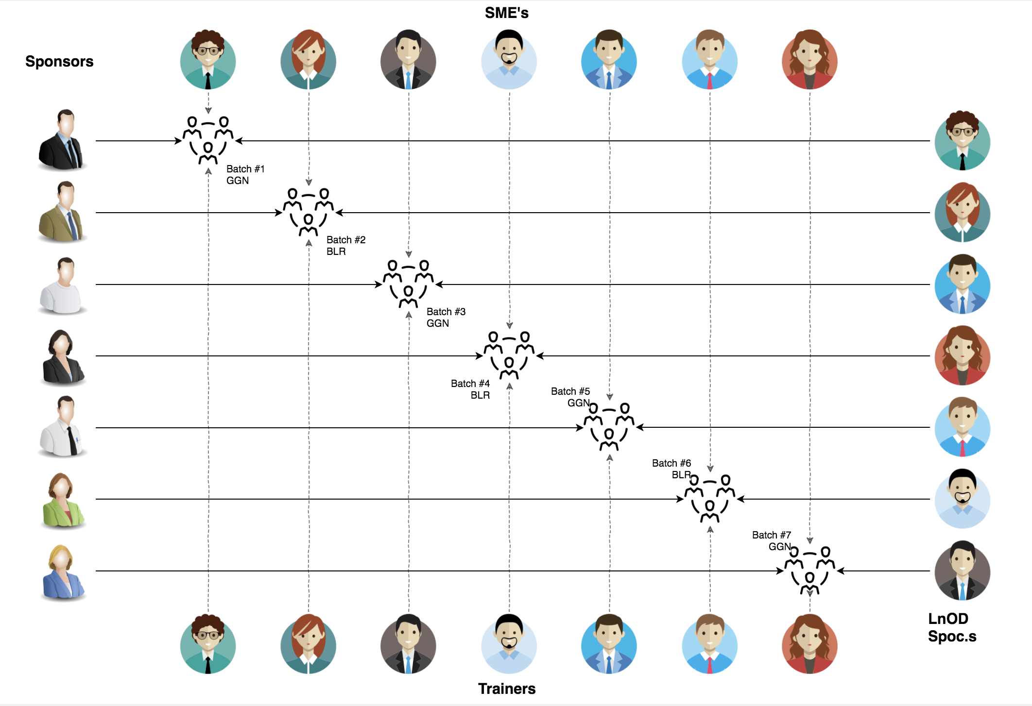
Stakeholders
Sponsors
Flipkart
Trainers
Amit Balyan
3. SME’s
Shree (Order Trainings)
Heena Bansal

Slide 3

Agenda
01
Our Journey
02
Our Team
03
Team Structure
04
Problem Statement
05
Engineering Practices
06
Tech Stack
07
Development
08
Challenges & Learnings
09
Demo
10
Questions
Notes:
Time – 1 min

Slide 4

Our Journey
Notes:
Highly excited to tell you about our journey in developing this project

Slide 5
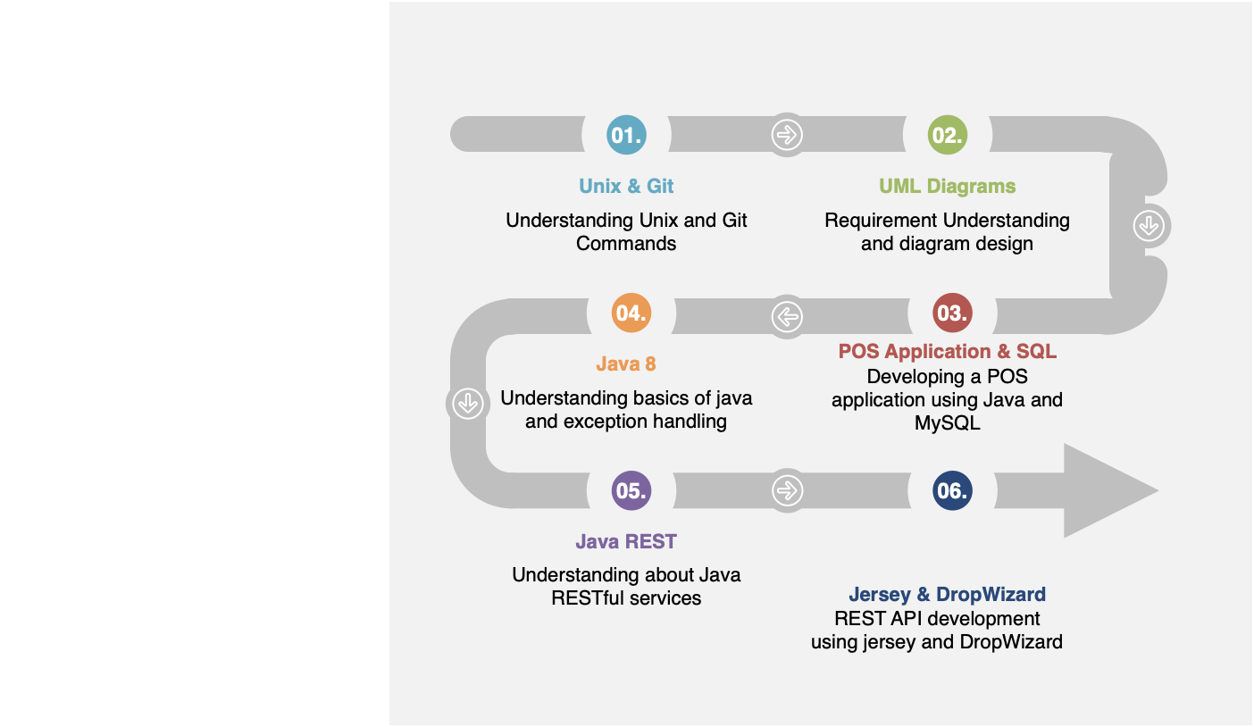
DAY 1-5
DAY 6-10
DAY 11
Notes:
Presented by Anmol Gupta
On Day 1 ,we installed the required softwares….IntelliJ,Git,Java.
On Day 2,we started tutorial on basic Unix and Git commands-1 assignment to create a Git repo and teams were created
On Day 3,We met our team and studied SDLC(Software Development Life Cycle) and the UML(Unified Modelling Language) diagrams.
SDLC->Waterfall Model,Iterative Model,Spiral Model,Agile Model
UML DIagrams-Use Case Diagram,Activity Diagrams,Class Diagrams,Sequence Diagrams
On Day 4,We drew Use case and Activity Diagram
On Day 5,We drew Class and Sequence Diagrams
On Day 6,We studied basic Java and POS applications
On Day 7,we added Skeleton of Beans,Services and Applications
On Day 8 and 9,we wrote implementations of all services,beans and applications integrating them with database using JDBC(Java Database Connectivity)
On Day 10,we added Exceptions,created Javadoc and used Java 8 features like for-each
On Day 11,learnt about RESTful services,Jersey and Dropwizard and used dropwizard to create Restful web services.

Slide 6
Our next starts
NOW
Notes:
How we approached

Slide 7
Demo
Testing
Process
5
Project Demo
Tools
4
Testing on Console, REST client such as Postman
Comprehend
3
Architecture Design and Development
2
Decide the Technology stack for console and REST API development
1
Understanding Project Requirements and Goals
Notes:
Understanding Requirements using UML diagrams.

Slide 8
1.5 WEEKS OF TRAINING + PROJECT DEMO
11 DAYS
88 HOURS
5280 MINUTES
316800 SECONDS
LIMITLESS KNOWLEDGE

Slide 9

Our Team
Notes:
Time – 2 mins

Slide 10
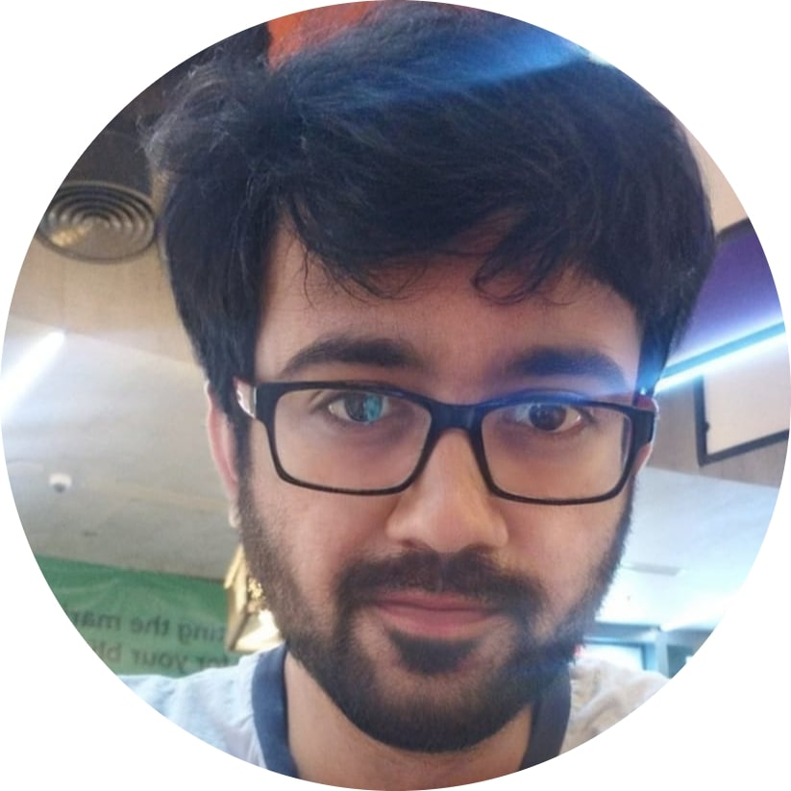
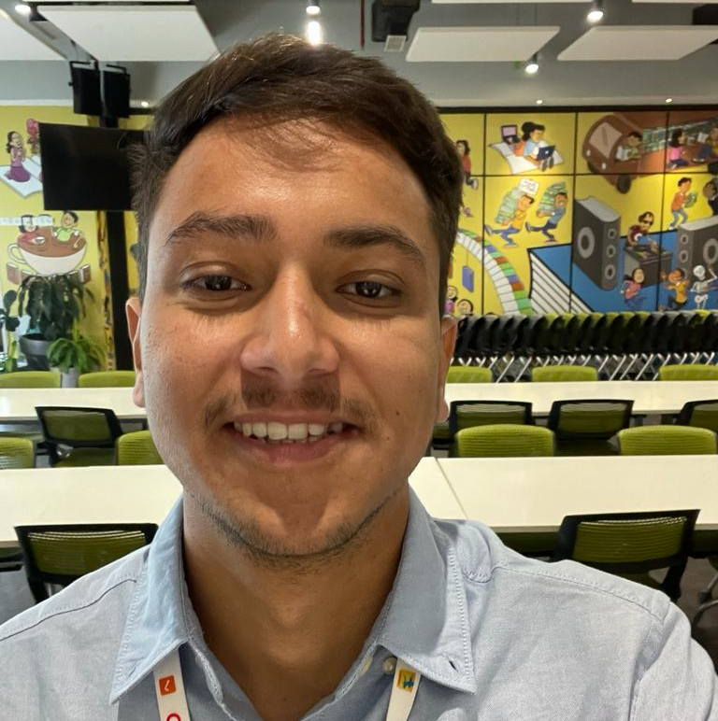
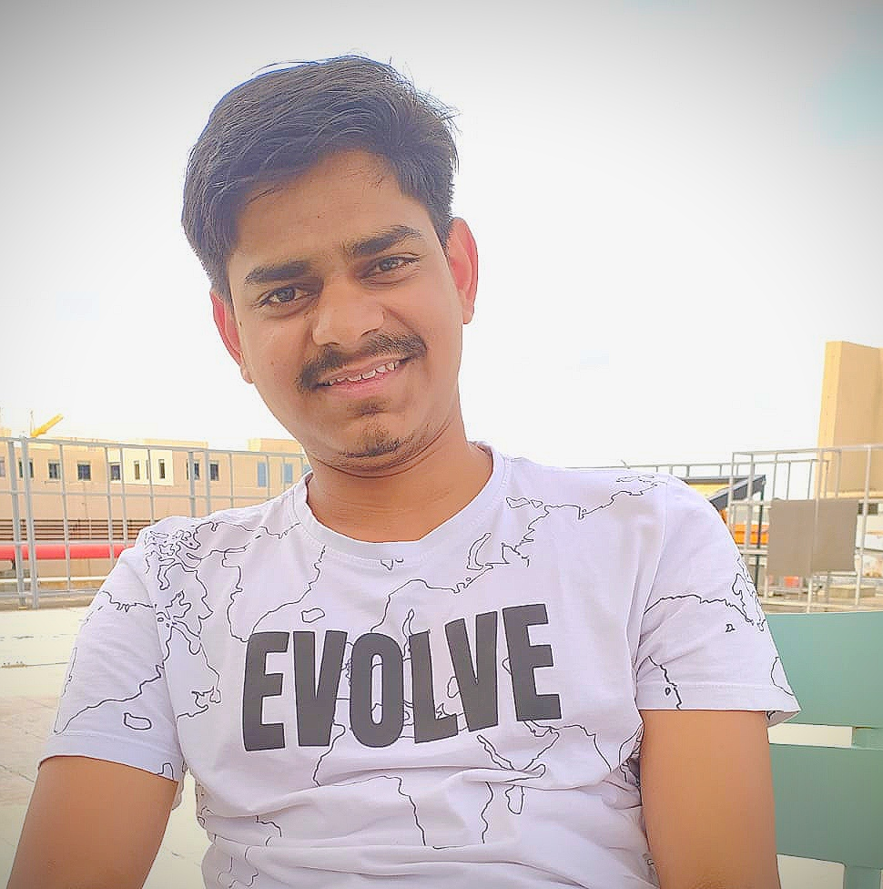
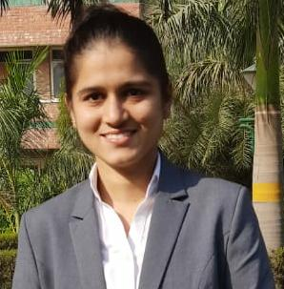
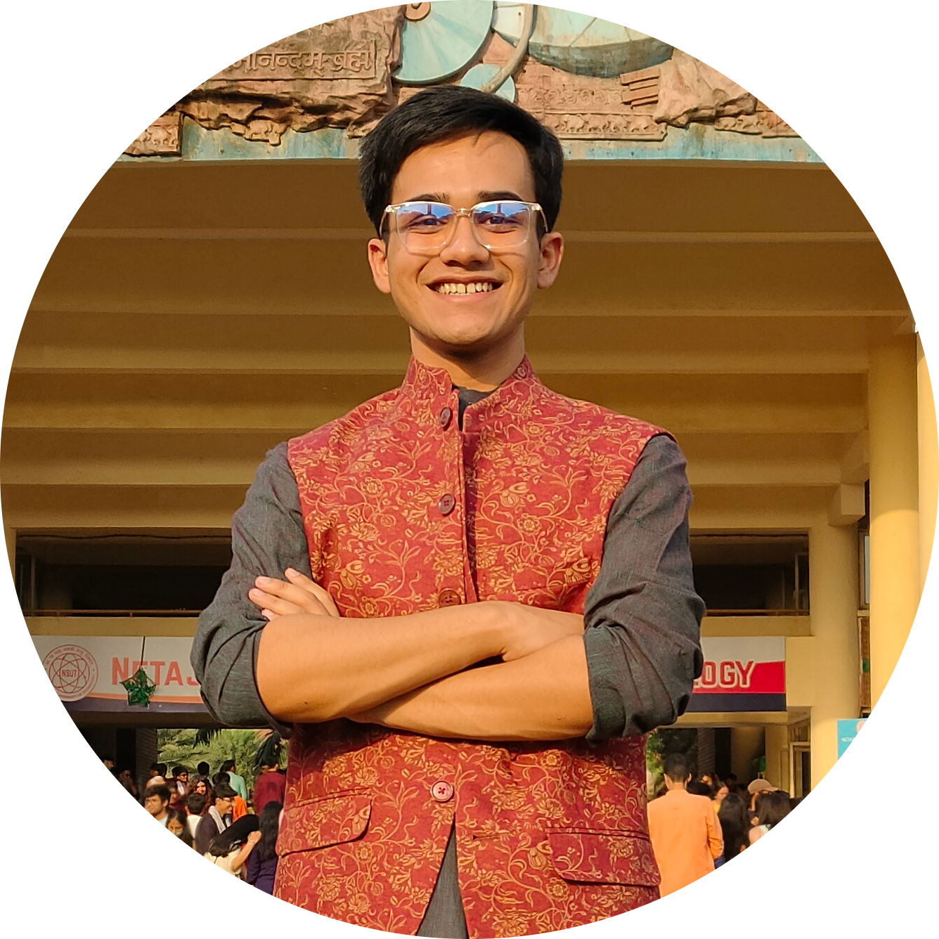
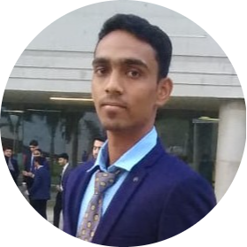
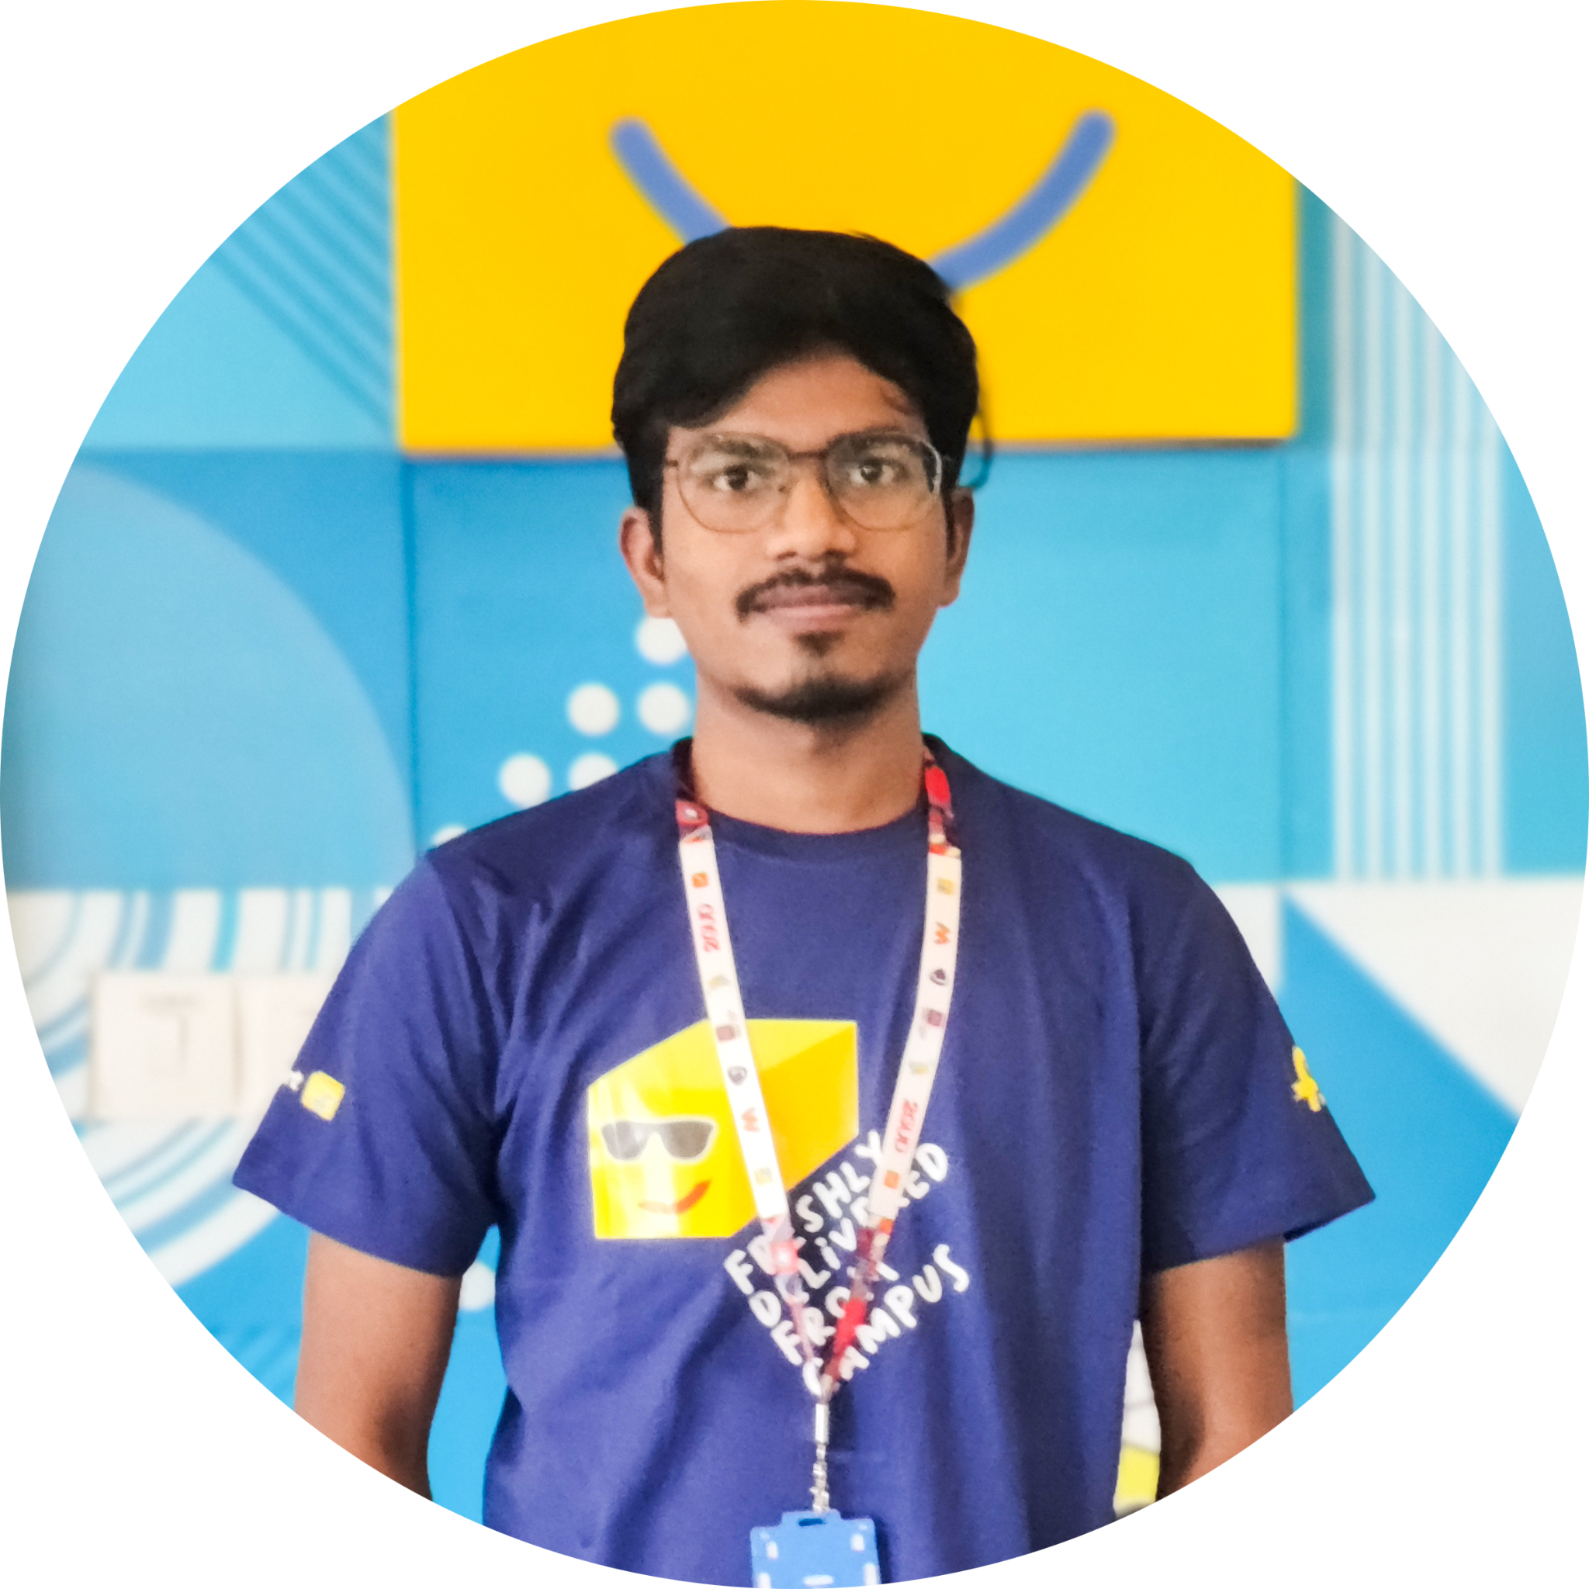
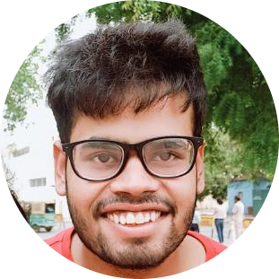
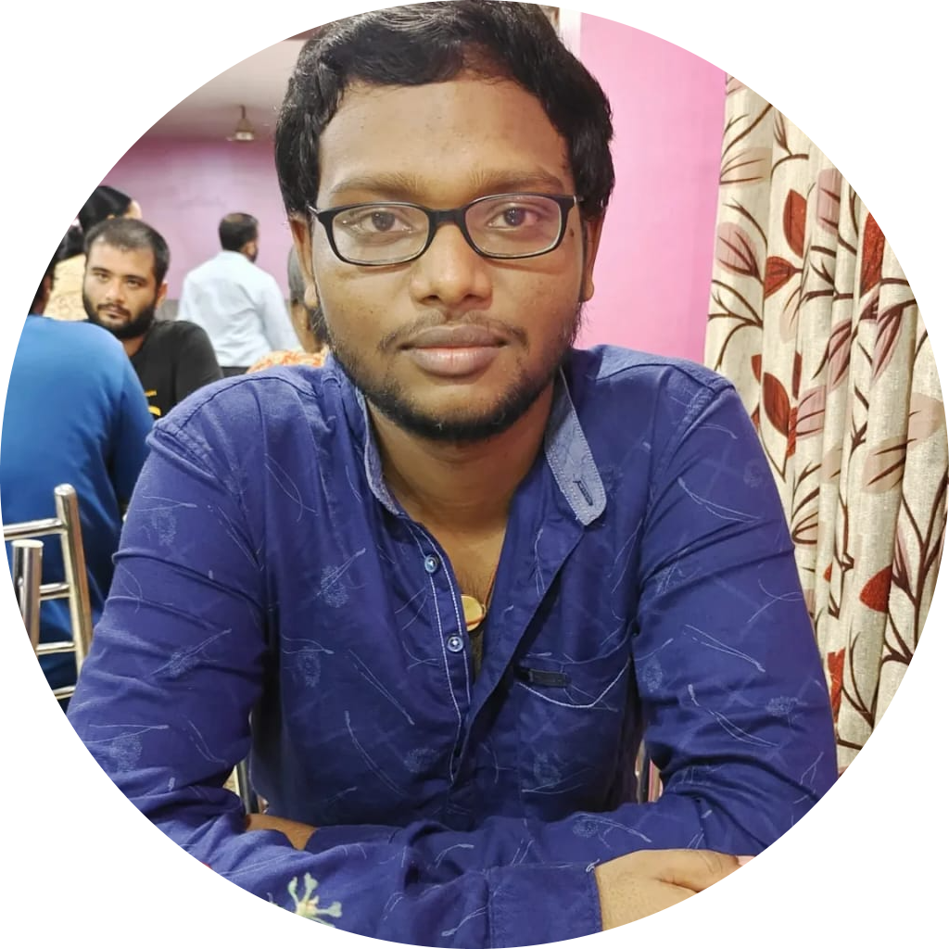
Akshat Gupta
Mohan Joshi
Paras Joshi
Avani Singh
Srijan Sarkar
Ritesh Parmar
Karan Karhale
Anmol Gupta
Rupesh Kumar Pallai
Notes:
Well, as it happens in a good team, we divided the work quite uniformly amongst ourselves giving us the best chance to not only learn and gain the desired knowledge but also, to be able to finish the project and the presentation within the deadline.

Slide 11

Project Goals
Notes:
Time – 3 mins

Slide 12
Problem Statement
Entities involved are: Student, Professor, Admin
Students should be able to Register for courses and view an electronic report card at the end of the semester.
Professors access the system to choose and teach courses, record grades.
The Admin should be able to Approve a Student, Register a Professor, add/remove course from course catalog.
The System should allow students to select courses. Students can add/drop courses.
Course offerings should have a maximum of ten students and a minimum of three students.
After the registration, the system sends information to the billing system so that the student can be billed for the semester.
Notes:
User satisfaction and brand value
Problem Statement

Slide 13




Our Vision
1
2
To develop a POS application and REST API for Course Registration System using JAVA/REST tools and technologies, where a professor as well as a student can view courses and enroll in some of the courses.
Quality
Security
3
4
Interactivity
Speed
Notes:
User satisfaction and brand value
Problem Statement

Slide 14

Engineering Practices
Notes:
Time – 5 mins

Slide 15
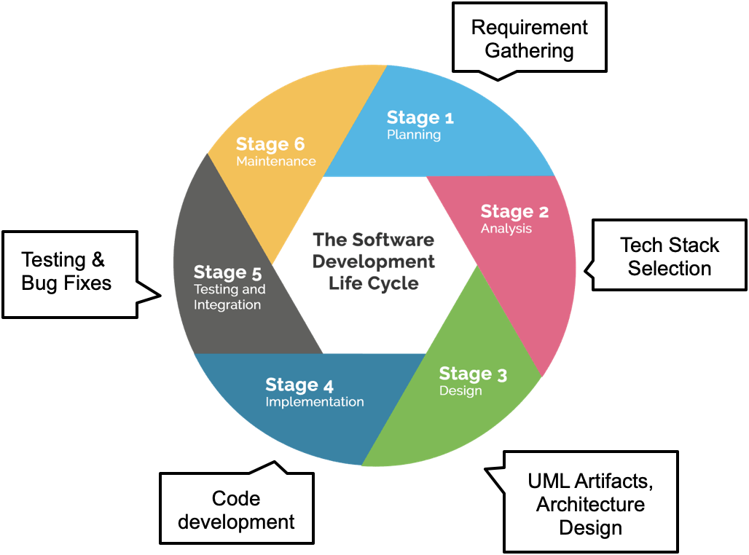
Notes:
Implementation ->

Slide 16
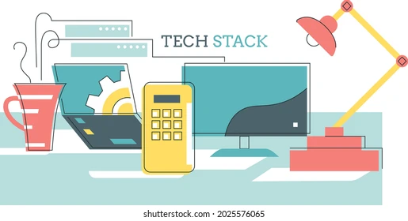
Tech Stack
Notes:
Time – 2 mins

Slide 17














Designing
Backend
Testing
Data
SCM
UML
Core Language
Tools
SQL Database
Code Collaboration
Framework
Application Server
Notes:
Time – 1 min
Java
Maven
DropWizard
MySQL
Jersey
GitHub
Postman / ARC (Check it)
StarUML / Dia / Lucid Charts
List
Design
Backend
Testing
Tools

Slide 18

Challenges & Learnings
Notes:
CHALLENGES
MAVEN SETUP
REST API TESTING
MERGE CONFLICTS
LEARNINGS
SDLC CONCEPTS
MVC ARCHITECTURE
TESTING APIS

Slide 19

CHALLENGES
Understanding the problem statement and initial implementation using Use Case, activity, sequence and class diagram.
Git merge conflicts.
Resolving jar and version dependencies.
Database integration challenges.
Working Remotely

Slide 20

LEARNINGS
Familiarization with Unix Commands.
Getting hang of the basic Git commands.
Software Development Life Cycle.
Knowledge and Implementation of Activity, Sequence and Use Case Diagram.
Java 8 features.
Integration of REST Services with Java code using Jersey.
Dropwizard Integration and Advantages.
Usage of Postman for testing APIs.
Javadoc Generation & basic Application Monitoring.

Slide 21

Architecture Design
Notes:
Time – 1 min

Slide 22

POS Application
Java Main Client
Business Code
Database Code
HTTP Request
HTTP Response

Slide 23

UML Diagrams

Slide 24
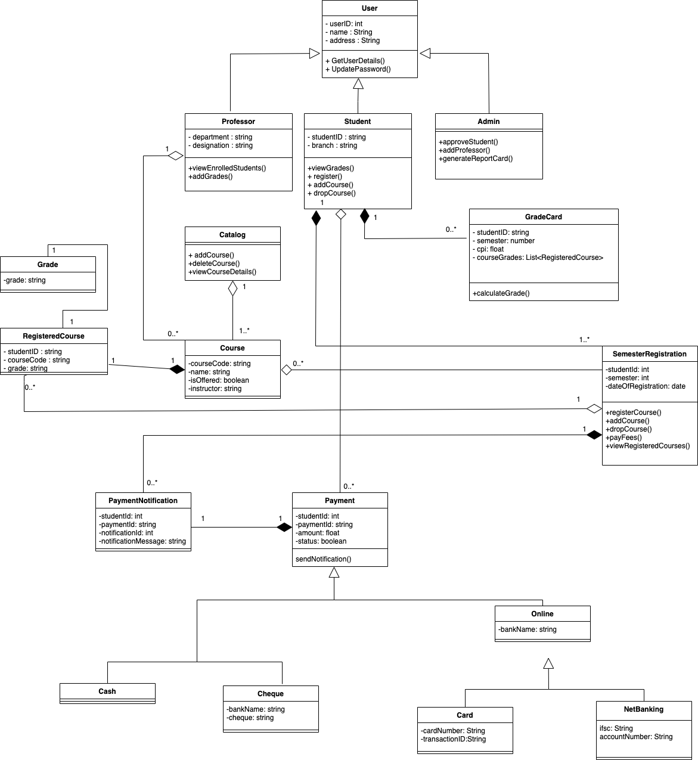
CLASS DIAGRAM

Slide 25
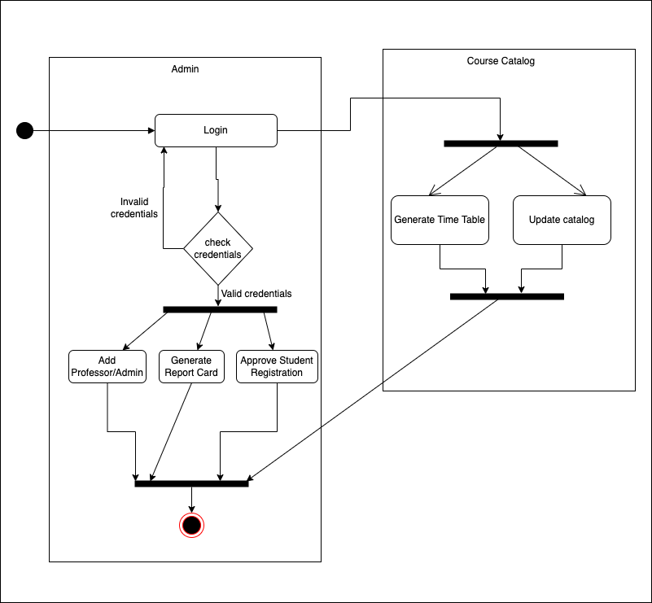
ACTIVITY DIAGRAM(ADMIN)

Slide 26
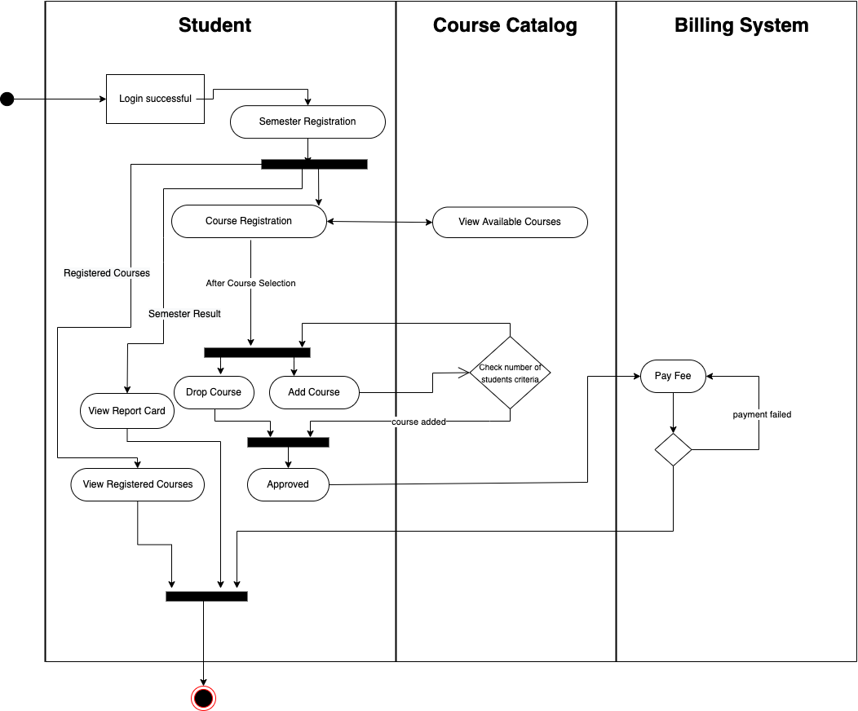
ACTIVITY DIAGRAM(STUDENT)

Slide 27
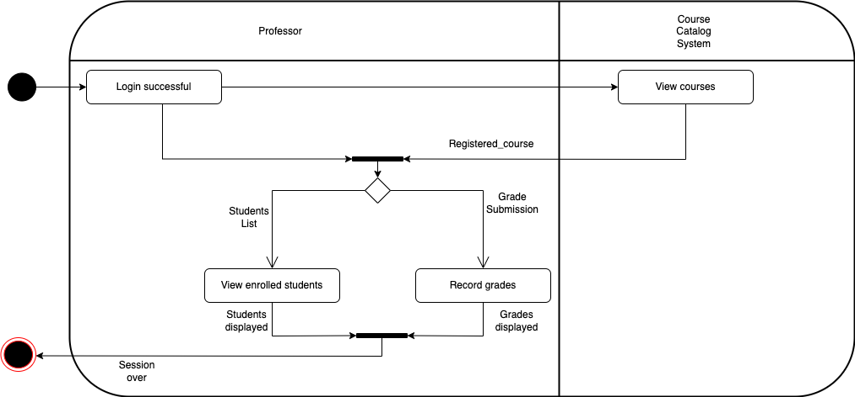
ACTIVITY DIAGRAM(PROFESSOR)

Slide 28
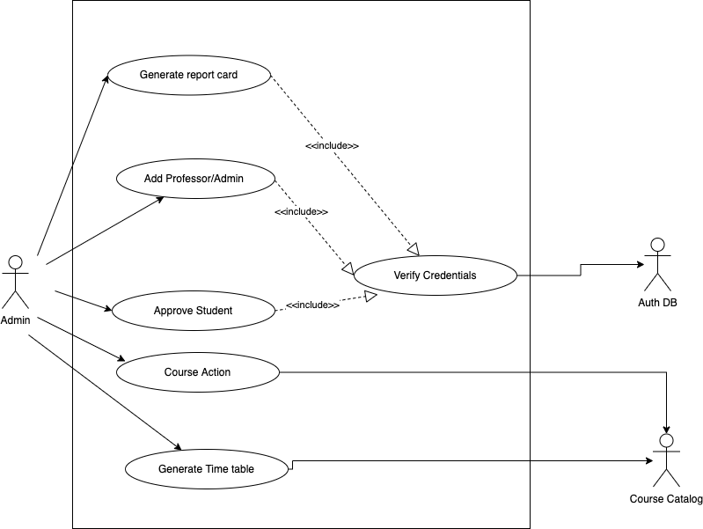
USE CASE DIAGRAM
(ADMIN)

Slide 29
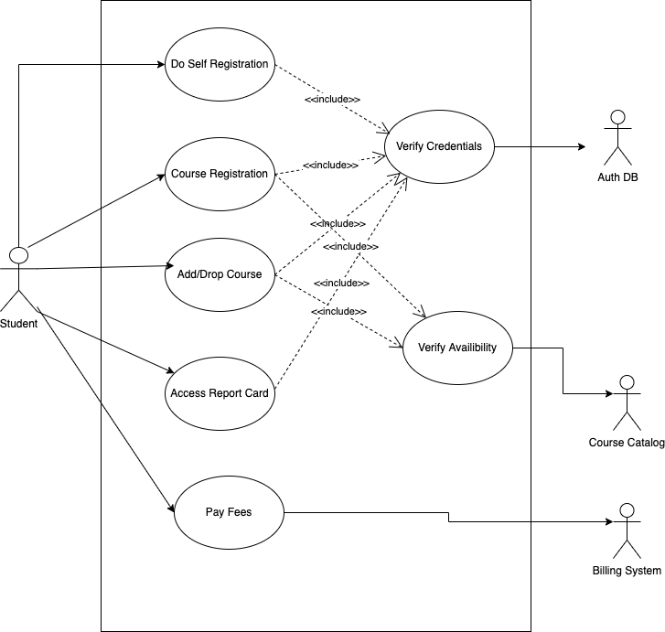
USE CASE DIAGRAM
(STUDENT)

Slide 30
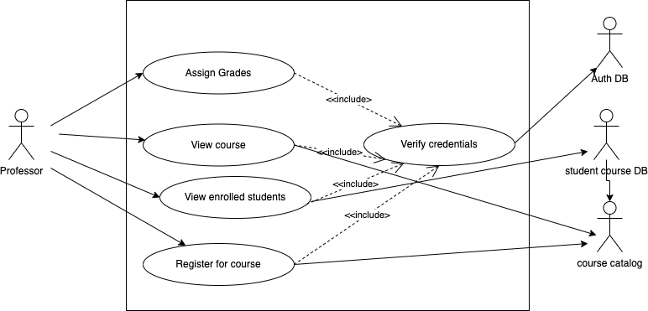
USE CASE DIAGRAM
(PROFESSOR)

Slide 31
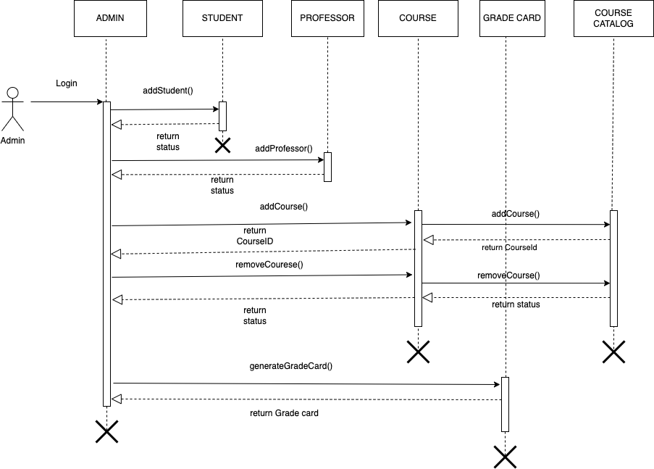
SEQUENCE DIAGRAM(ADMIN)

Slide 32
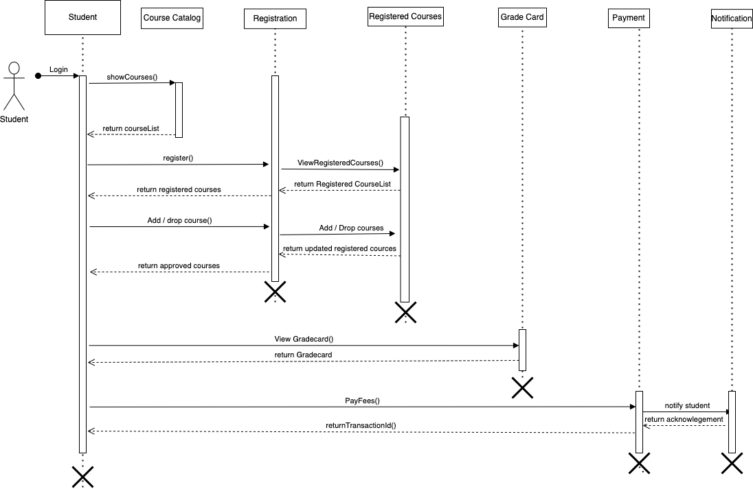
SEQUENCE DIAGRAM(STUDENT)

Slide 33
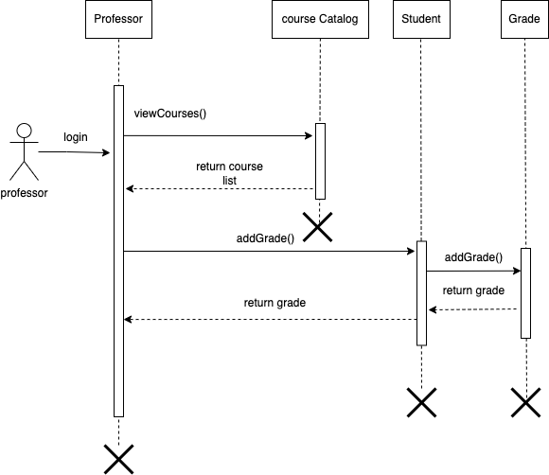
SEQUENCE DIAGRAM(PROFESSOR)

Slide 34
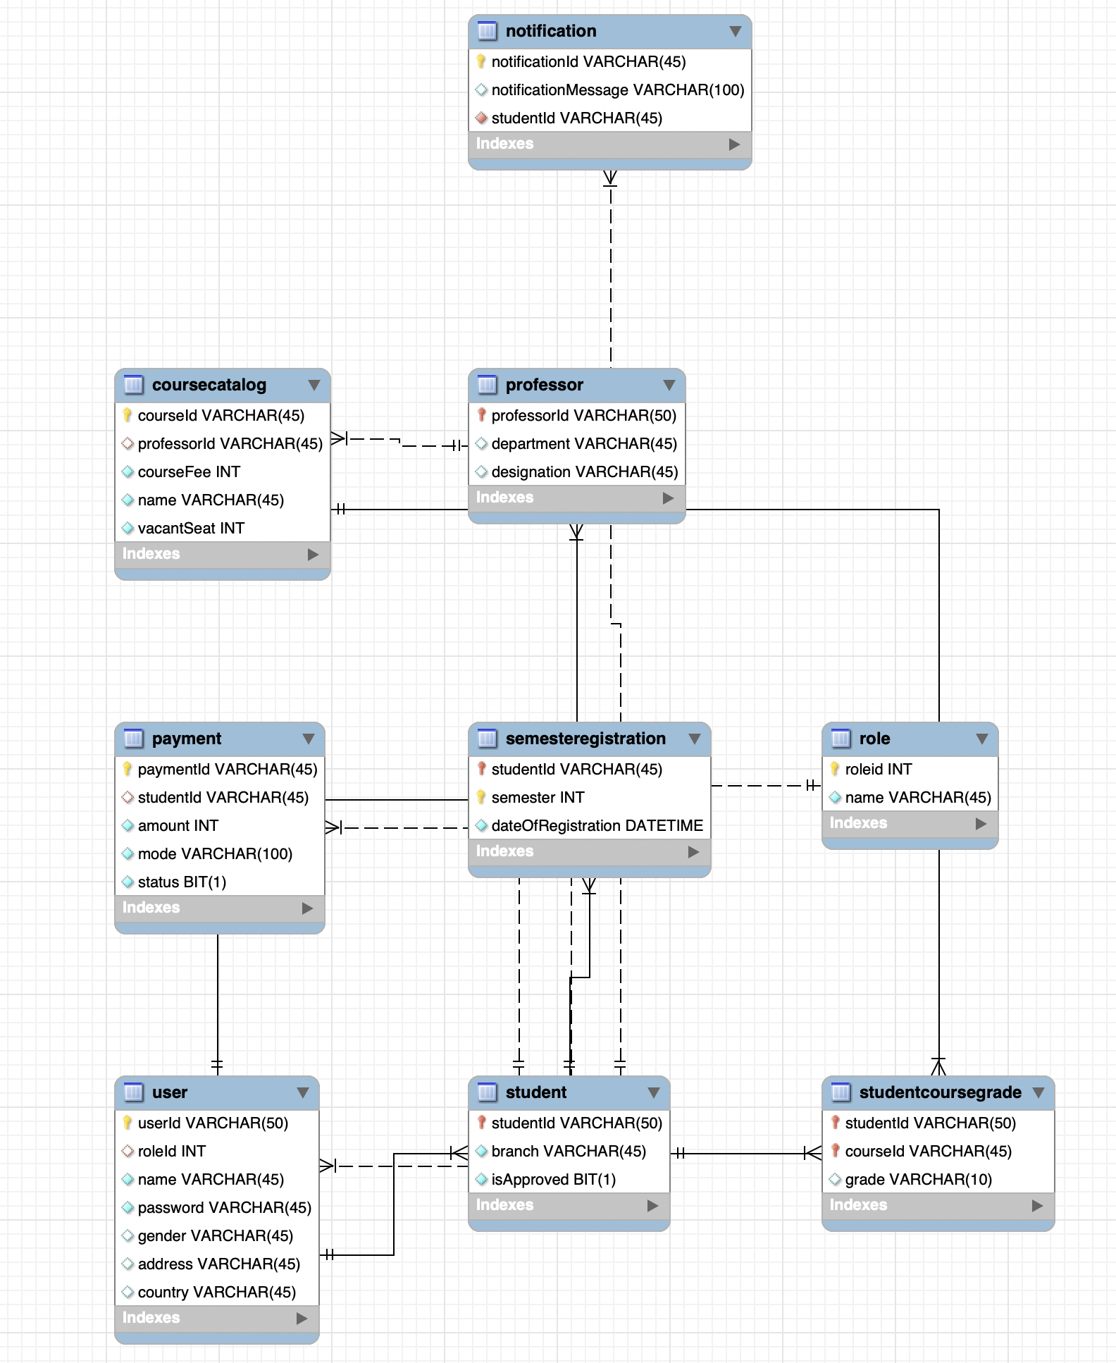
DATABASE SCHEMA

Slide 35

Demo

Slide 36
Thank you :)

